Slide 1
Determinants
3.2 Properties of Determinants
Bumhee Cho

Slide 2
Theorem 3. Row Operations
Let A be a square matrix
a. If a multiple of one row of A is added to another row to produce a matrix B, then det B = det A
b. If two rows of A are interchanged to produce B, then det B = -det A
c. If one row of A is multiplied by k to produce B, then det B = k ⋅ det A

Slide 3
det EA = (det E)(det A)
det E = 1, -1, or r
true for n = 2
when n = 3
B = EA
unaffected row i
det B_{ij} = α ⋅ det A_{ij}
det EA = a_{i1}(-1)^{i+1} det B_{i1} + ⋯ + a_{in}(-1)^{i+n} det B_{in}
= αa_{i1}(-1)^{i+1} det A_{i1} + ⋯ + αa_{in}(-1)^{i+n} det A_{in}
= α ⋅ det A
⋮

Slide 4
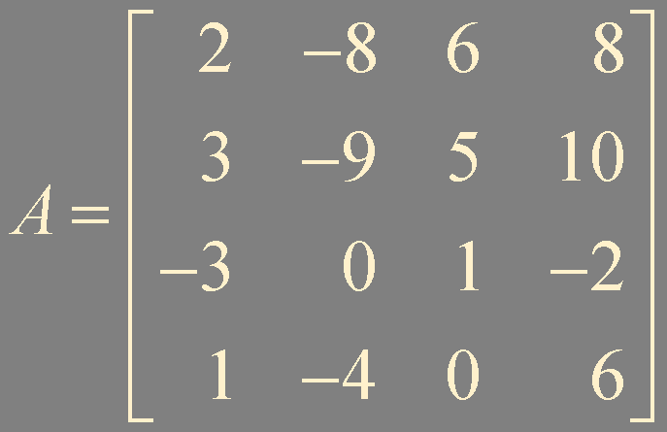
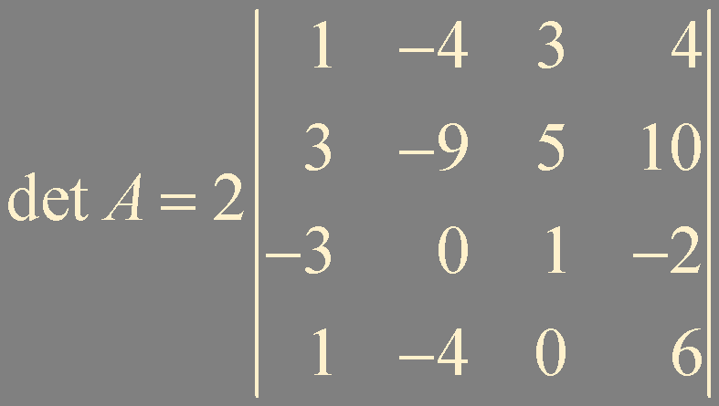
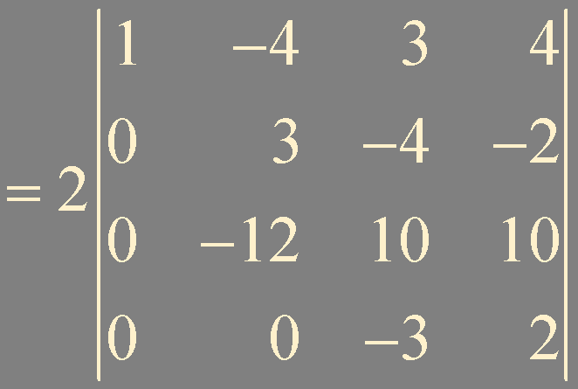
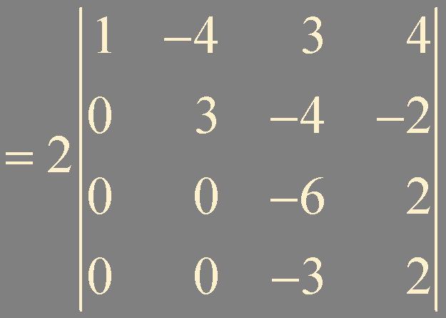
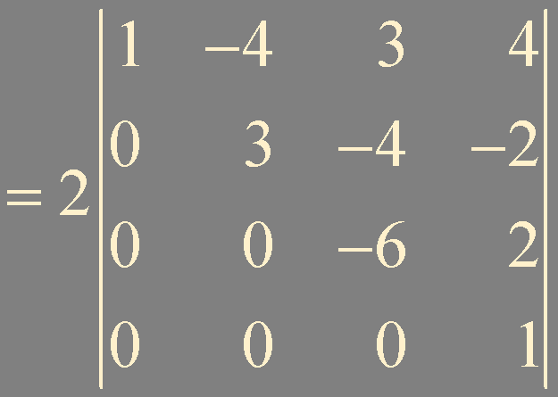

Example 1.
det A = (-1 or 1) ⋅ product of pivots in U when A is invertible
or = 0 when A is not invertible

Slide 5
Numerical Note
To calculate a determinant by cofactor expansion, it requires over n! multiplications. 25! is around 1.5 × 10²⁵
To calculate a determinant using row operations requires about 2n³/3 operations
n = 25, 10,000 operations

Slide 6
Theorem 4
A square matrix A is invertible if and only if det A ≠ 0

Slide 7
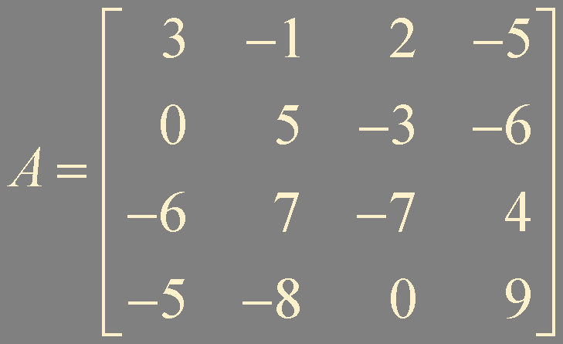
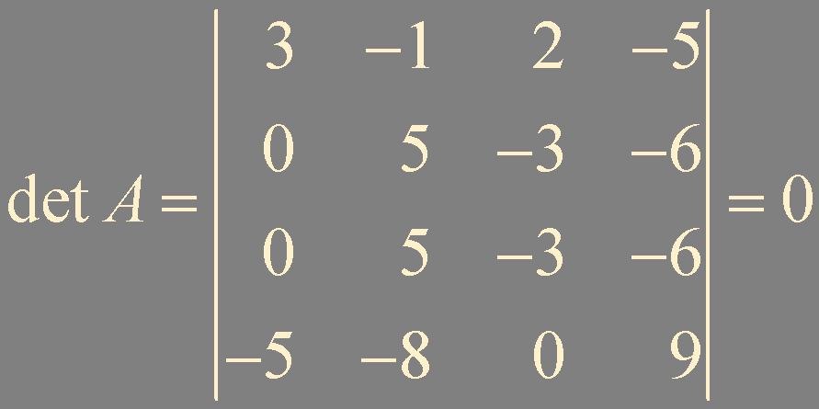
Example 4.

Slide 8
Theorem 5.
If A is an n × n matrix,
then det A^{T} = det A
true for n = 1
when n = 2
(1, j)-cofactor
(j, 1)-cofactor
⋮

Slide 9
Theorem 6. Multiplicative Property
If A and B are n × n matrices,
then det AB = (det A)(det B)
det A + B ≠ det A + det B in general

Slide 10
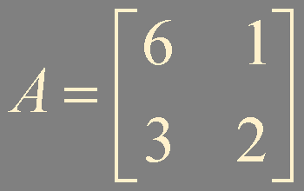
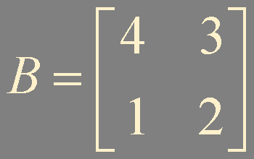
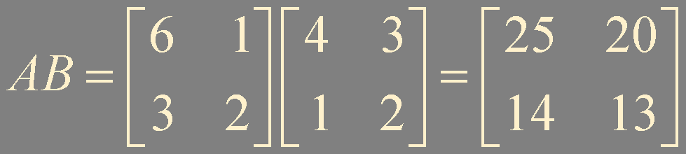


Example 5.

Slide 11
If A is not invertible, then neither is AB
ABW = I A(BW) = I
det AB = (det A)(det B)
If A is invertible
A ~ E_{p}E_{p-1}⋯ E₁⋅I_{n} = E_{p}E_{p-1}⋯E₁
|AB| = |E_{p}E_{p-1}⋯ E₁B|
= |E_{p}|⋯ |E₁| |B|
= |E_{p}⋯ E₁| |B|

Slide 12
Summary
Determinant changes by row operations
det A ≠ 0
det A^{T} = det A
det AB = (det A)(det B)

